Slide 1
IMAGE RECOGNITION AND SEPARATION
MATLAB PROJECT BY:
1)L.Anvesh Reddy(PES1201801299)
2)Rajdeep Sengupta(PES1201800144)
3)P.Teja(PES1201800408)

Slide 2
INTRODUCTION
Traffic control and vehicle owner identification has become major problem in every country. Sometimes it becomes difficult to identify vehicle owner who violates traffic rules and drives too fast. Therefore, it is not possible to catch and punish those kinds of people because the traffic personal might not be able to retrieve vehicle number from the moving vehicle because of the speed of the vehicle.
In today’s world, everything is computerized so why not develop a system for this issue?
So in this project, we developed a system using MATLAB to resolve this issue.
NOTE: Due to COVID-19 disturbance, all the 3 members in our group used different .m files to do their part.

Slide 3
FUNCTIONS USED
1.Template Creation:
We have stored the binary images of all the alphabets and numbers in the sub-folder named as alpha.
We then assigned every alphabet to read the images from alpha folder using imread function.
A=imread(‘alpha/A.bmp’);
Where A is a variable,alpha is folder name,A.bmp is image in that folder resembling the A alphabet.
Later that ,we create a matrix of ‘alphabets’ and ‘numbers’ and save it in New template by using the command save(filename,variablename);

Slide 4
FUNCTIONS USED
2.Plate_detection:
imgray = rgb2gray(im);
imbin = imbinarize(imgray)
im = edge(imgray, 'prewitt');
After converting it to a binary image,We use Prewitt method which uses a gradient method to extract all the edges of the image

Slide 5
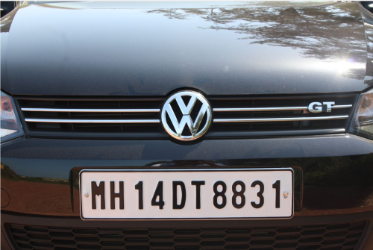
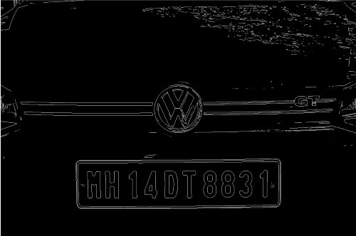
Original Image After Edge Detection

Slide 6
FUNCTIONS USED
After edge detection, we used a function known as regionprops which returns measurements of each 8 connected component in a binary image,We use it find all the connected components in the images,after looping through all the bounding boxes in an image we select the region and crop the image with regions which has the largest area because car plate in the back of the car has the largest continuous area.
Iprops=regionprops(im,'BoundingBox','Area', 'Image');
After that,we use a function known as bwareaopen to remove all the objects which has width higher than 500 and also we inverse the image by using Arithematic operator(~).
im = bwareaopen(~im, 500);

Slide 7
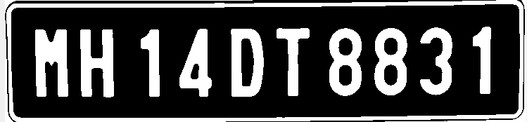

FUNCTIONS USED
After cropping the largest area we get an image of the Car plates like this
We use regionprops again to extract the individual letters(based on Height) and identify them by using a function Letter_Detection,and store each letter in a variable noPlate.

Slide 8
FUNCTIONS USED
3.Letter detection:
The function readLetter takes each character in the image and uses the template created with defaults to compare using corr2() function and stores the correlation value in an array called ‘rec’. Then it finds the maximum correlation value from the ‘rec’ array and concludes that the character matches the following default value. This is the concept we have used in place of machine learning.
So the maximum correlation value is found using the find() function in the ‘rec’ array and the value of that character is mapped to the index in the template created.

Slide 9
APPLICATIONS
Parking - to calculate parking charge for vehicles based on their number plates
Access Control - gates automatically opening for registered vehicles
Toll Gates - find the toll charge for vehicles based on their number plates
Stolen Cars - track the stolen vehicle based on number plate
Traffic Control - find which vehicles jump red lights

Slide 10
FUTURE WORK
This project can be extended for further use. The algorithm we have used can be used to identify number plates from a video. In this way, traffic controllers can use it in real time instead of taking pictures at regular intervals.
Also this algorithm can be modified using deep learning and natural language processing to identify characters from number plates. This might give better accuracy.

Slide 11
Conclusion
We have splitted the project among three of us equally by splitting the code into 3 files to make project easier. They are 1)template_creation.m file, 2)Letter_detection.m file 3)Plate_detection.m file
In the template_creation.m file we have written the code to store the binary images of numbers and alphabets and put it in a directory called Newtemplates. Then the directory is called in the file called letter_detection.m.
Then, in Plate_detection.m, we call Letter_detection.m file and then we process the image. After that, the detected image and detected number on number plate is printed into the command window as final output.

